Slide 1
Lesson 2

Slide 2
Vocabulary: Eating out Grammar: Noun (2)
TABLE OF CONTENTS

Slide 3
Vocabulary

Slide 4

basic
adj., serving as a starting point or basis; simple
a. The new restaurant offers a very basic menu. b. The restaurant manager ordered enough basic supplies to get through the first month

Slide 5

complete
v., to finish or make whole
a. We ordered some dessert to complete our meal. b. Some restaurants want to hear their customers' opinions and ask them to complete a short evaluation form.

Slide 6

excite
v., to arouse an emotion
a. Exotic flavors always excite me. b. The new Asian restaurant has excited the interest of many people.

Slide 7

flavor (n) a distinctive taste
a. Fusion cooking is distinguished by an interesting mix of flavors. b. The cook changed the flavor of the soup with a unique blend of herbs.

Slide 8

forget v. to be unable to remember
a. The waiter forgot to bring the rolls, annoying the customer. b. Don't forget to tell your friends what a great meal you had tonight.

Slide 9

ingredient n. an element in a mixture
a. The chef went to the farmer's market to select the freshest ingredients for tonight's menu. b. I was unfamiliar with some of the ingredients in the dish.

Slide 10

judge v. to form an opinion
a. Hector was not familiar with Asian cooking, so he was unable to judge if the noodles were cooked correctly. b. The restaurant review harshly judged the quality of the service.

Slide 11

mix-up n., a confusion
a. There was a mix-up in the kitchen so your order will be delayed. b. There was a mix-up about the ingredients and the dish was ruined.

Slide 12

patron n., a customer, especially a regular customer
a. Once the word was out about the new chef, patrons lined up to get into the restaurant. b. This restaurant has many loyal patrons.

Slide 13

predict v., to state, tell about, or make known in
a. I predicted this restaurant would become popular and I was right. b. Kona was unable to predict what time Andy, who is always late, would show up at the restaurant

Slide 14

randomly adv., without any specific pattern
a. We randomly made our selections from the menu. b. That chef chooses his spices randomly, but his dishes always taste great

Slide 15

remind v., to cause to remember
a. Ms. Smith was annoyed at having to remind the waitress to bring the check. b. I reminded the client that we are meeting for dinner tomorrow.

Slide 16
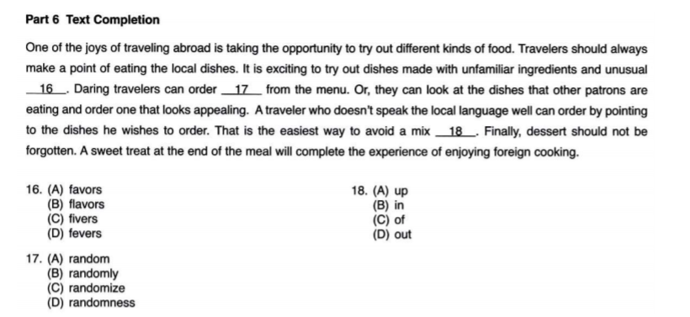

Slide 17
Grammar: Nouns (continued)

Slide 18


Slide 19
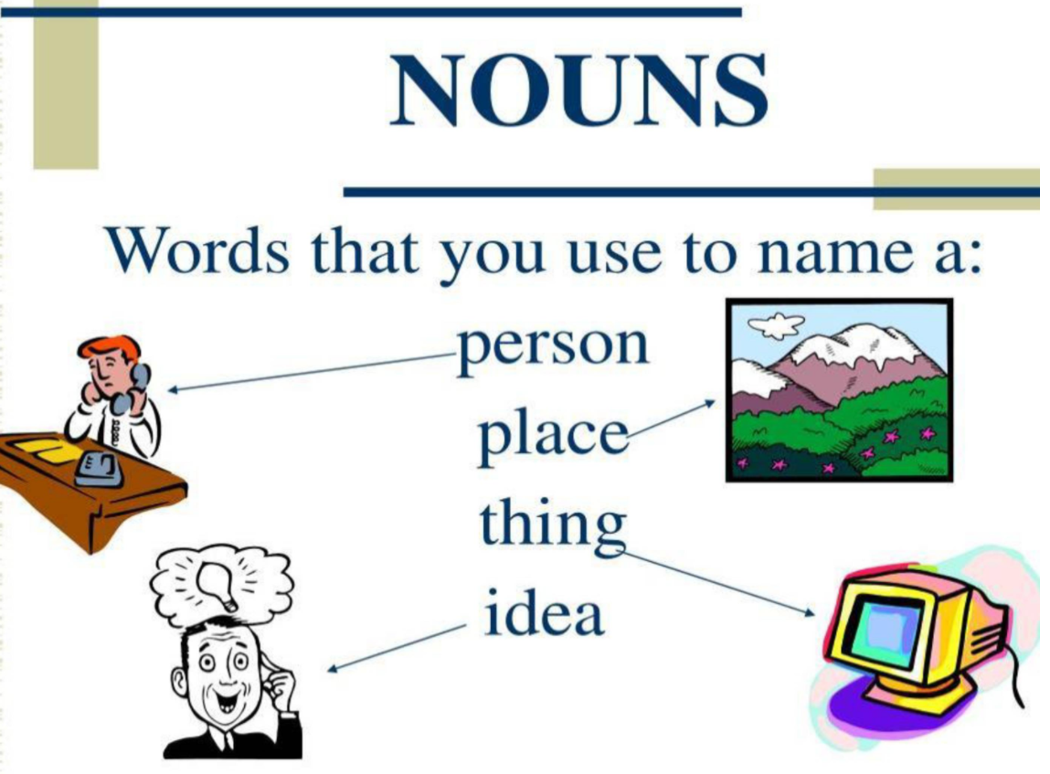
I. Functions of a noun

Slide 20
Complete the following worksheet as quickly as possible!
https://www.liveworksheets.com/worksheets/en/English_as_a_Second_Language_(ESL)/Nouns/Identifying_nouns_hi1356382fd

Slide 21
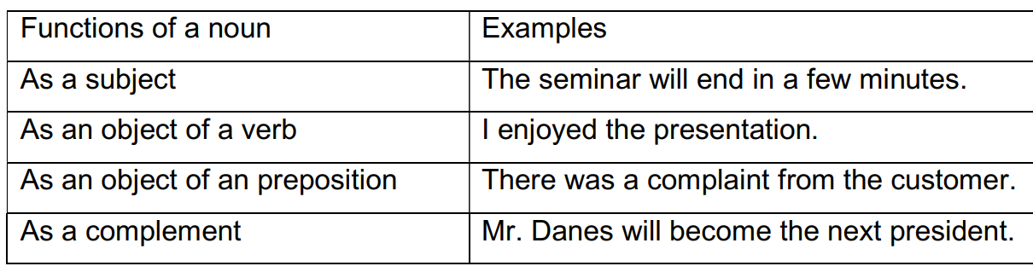
I. Functions of a noun
In a sentence, a noun has one of the following functions:

Slide 22
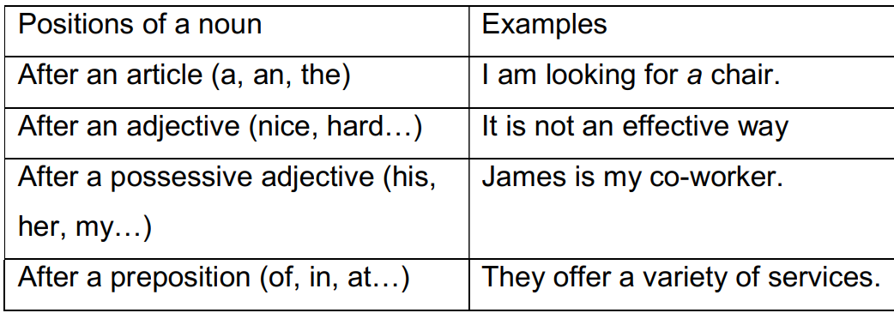
II. Positions of a noun
In a sentence, a noun is usually found after an article, an adjective, a possessive adjective, or a preposition

Slide 23
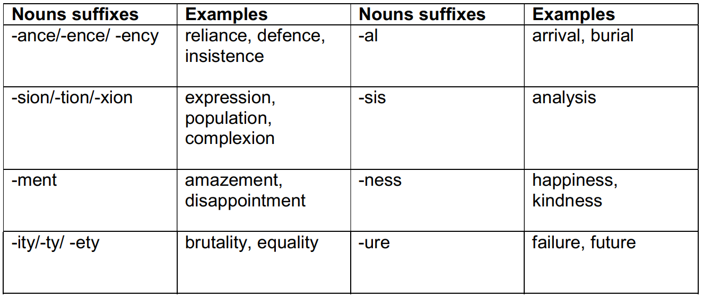
III. Noun suffixes
When a noun suffix is added to a verb or an adjective, a noun will be formed.

Slide 24
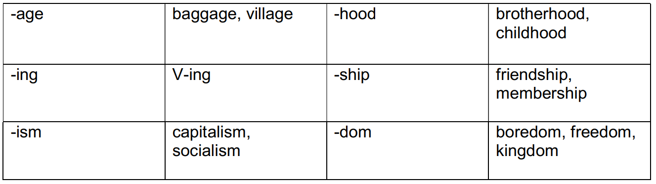
III. Noun suffixes
When a noun suffix is added to a verb or an adjective, a noun will be formed.

Slide 25


Noun suffixes: Occupations & people
When the suffix –ant, -or/-er, -ist or –ee is added to a verb or an adjective, a noun which means
“a person who does an action” is formed.
accountant
assistant

Slide 26

Noun suffixes: Occupations & people
interviewee
interviewer

Slide 27


Noun suffixes: Occupations & people
actor
trainee

Slide 28


Noun suffixes: Occupations & people
scientist
artist

Slide 29
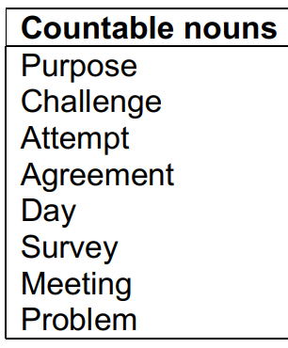
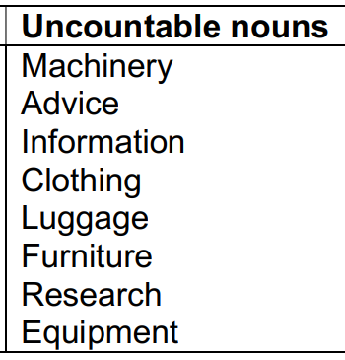
IV. Confusing countable
& uncountable nouns

Slide 30

V.

Slide 31
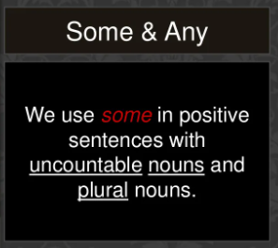

Slide 32
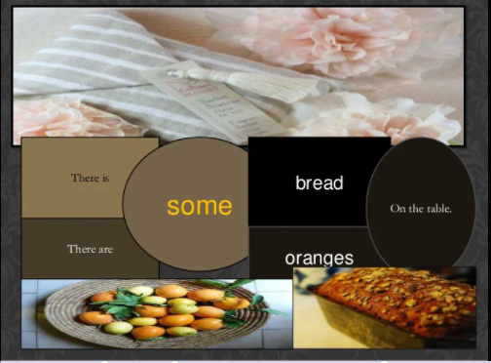

Slide 33
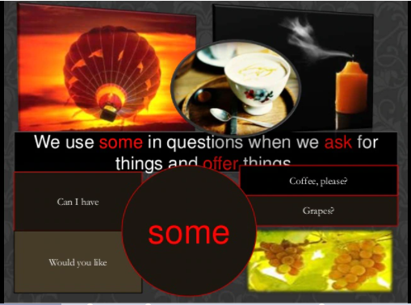

Slide 34
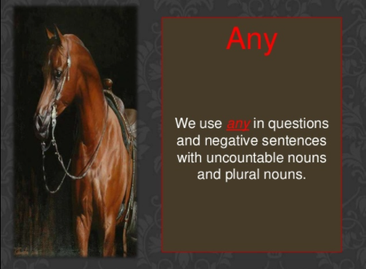

Slide 35


Slide 36
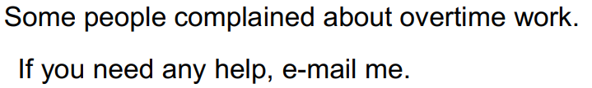
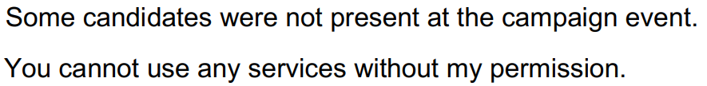
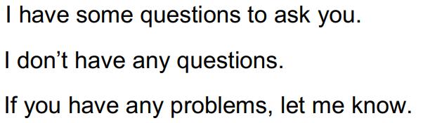
Some more examples

Slide 37
PRACTICE
Pages 9-10

Slide 38
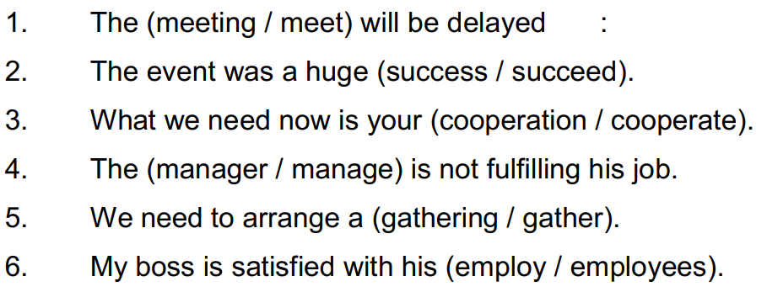
Exercise 1
Choose the correct noun in brackets for each sentence.

Slide 39
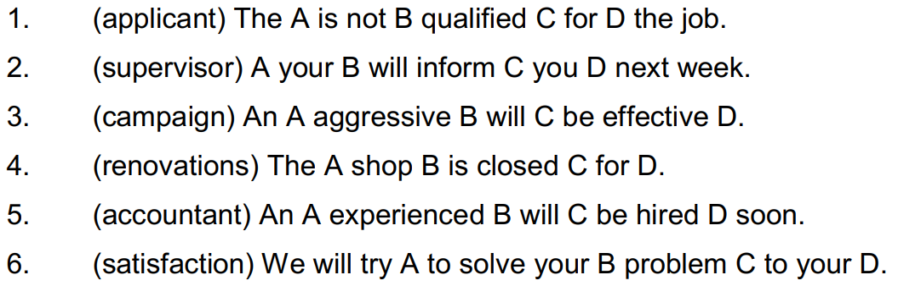
Exercise 2
Place the nouns in brackets in the correct position
(A), (B), (C) or (D)

Slide 40
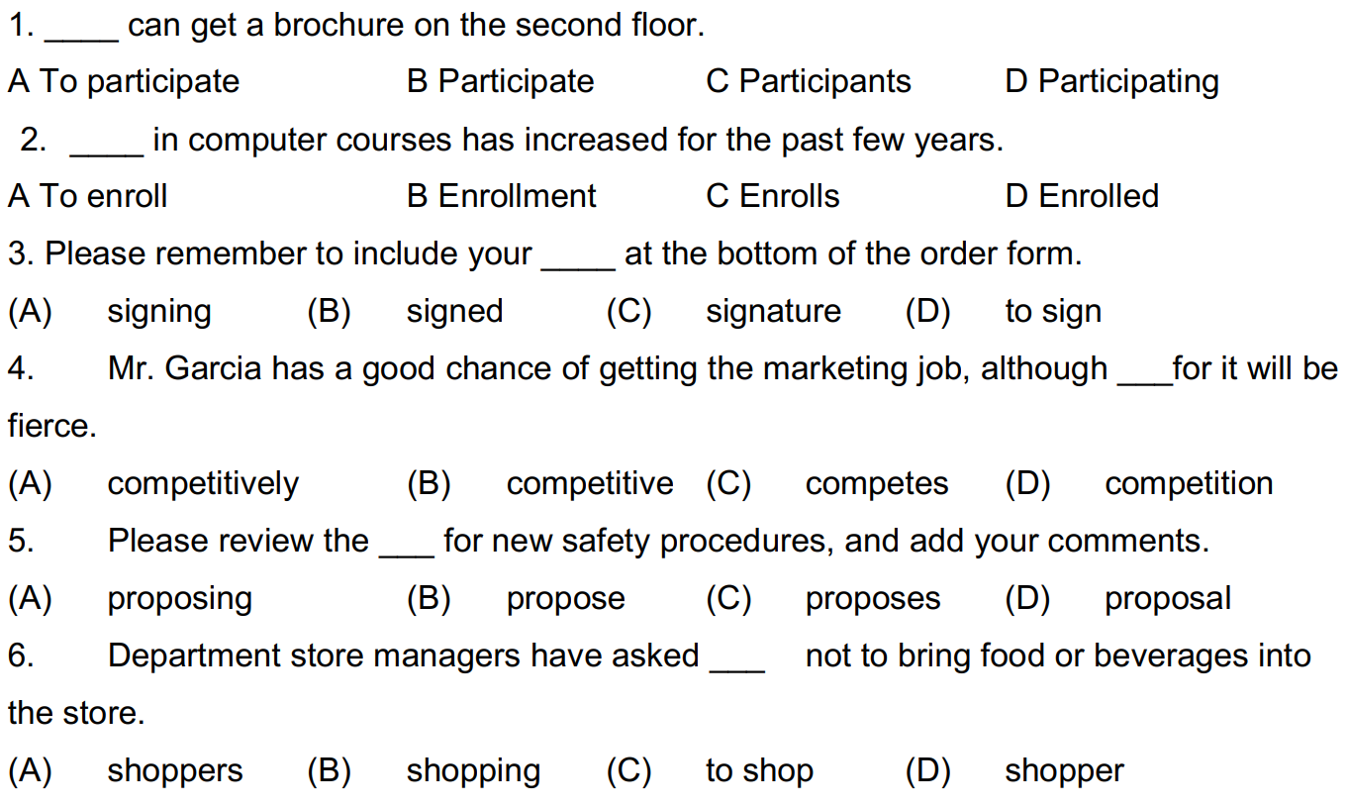
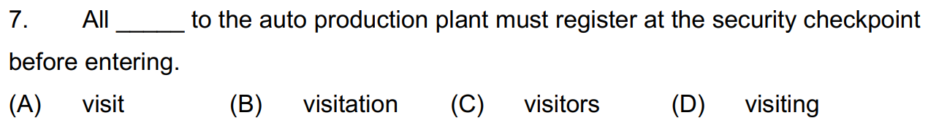
Exercise 3
Choose the correct option to complete each sentence.

Slide 41
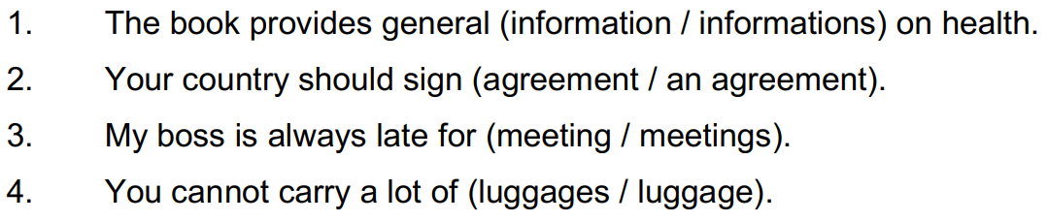
Exercise 4
Choose the correct noun in brackets for each sentence.

Slide 42
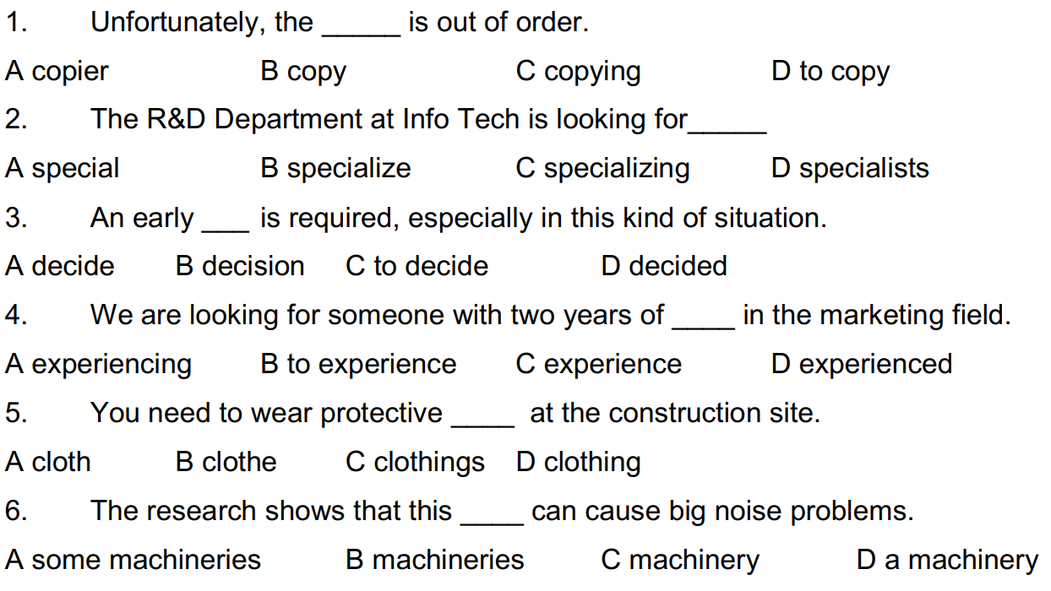
Exercise 5
Choose the correct option to complete each sentence.

